Slide 1
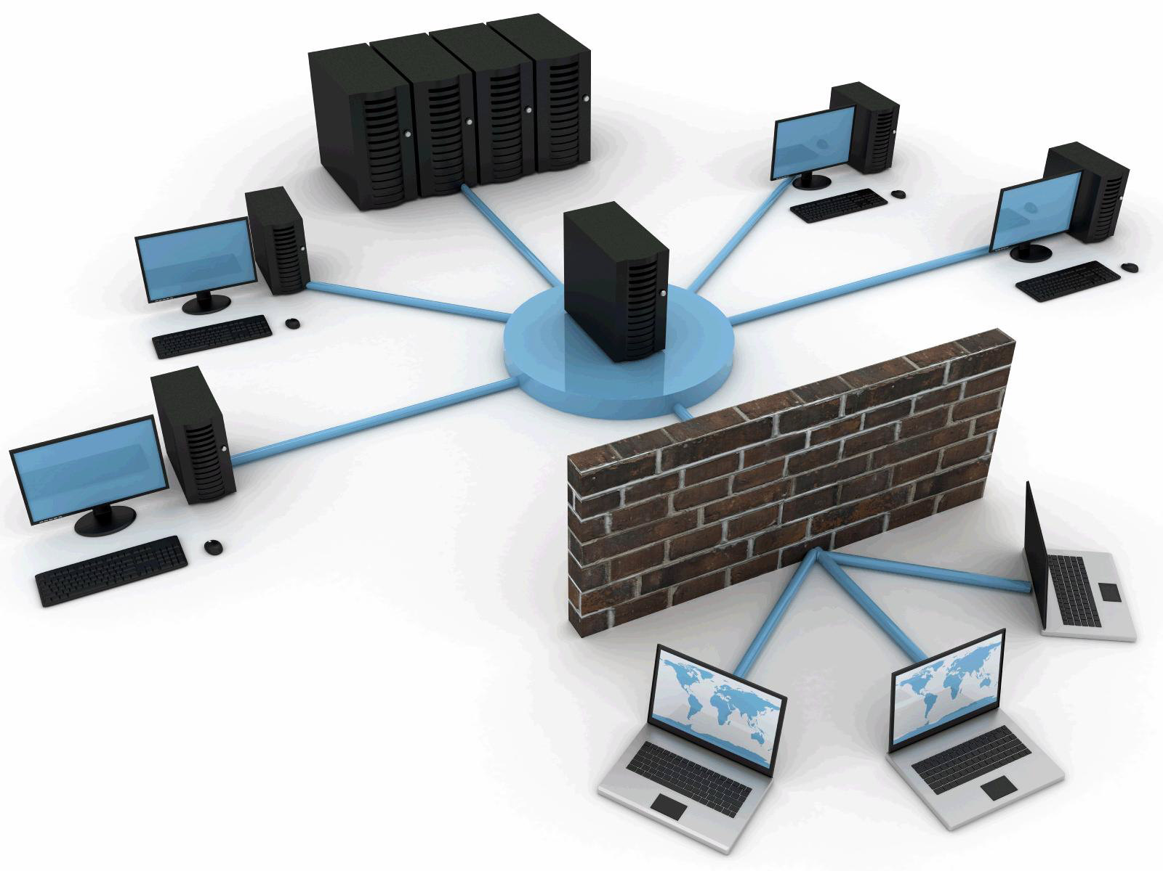


Slide 2

Physical Security
Protection of person, hardware, software, network & data from physical action.
Loss or damage.
Protection from fire, natural disaster, burglary, theft and terrorism.

Slide 3


Hardening Physical Security
Lock up the server room.
Set up surveillance.
Make sure the most vulnerable devices are in the locked room.
Use rack mount servers.
Don't forget the workstations.
Keep intruders from opening the case.
Protect the portables.
Pack up the backups.
Disable the drives.
Protect your printers.
Exterior physical security controls.
Interior physical security controls.
Environmental physical security controls.

Slide 4
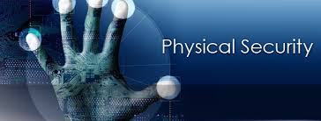
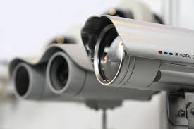


(EPS)Electronic physical security :-
Biometric Devices.
Security Cameras.
Motion Sensors.
Challenges in Ensuring Physical Security ?

Slide 5
Network Security
Authorization of access to data in a network.
Network security covers a variety of computer networks, both public and private.
Combines multiple layers of defenses at the edge and in the network.
Each network security layer implements policies and controls.
Protect proprietary information from attack.
Ultimately it protects your reputation.

Slide 6

Functions of Network Security Administrator
Defend systems against unauthorized access, modification and/or destruction.
Perform vulnerability and network scanning assessments.
Monitor network traffic for unusual activity.
Implement network security policies, application security, access control and corporate data safeguards.
Configure and support security tools.
Analyze and establish security requirements .
Train fellow employees in security awareness and procedures.
Conduct security audits and make policy recommendations.

Slide 7
Types of Network Security :-
H.W
Access Control
Anti-virus & Anti-Malware Softwares
Application Security – e.g E-mail
Data loss prevention
Email security
Firewalls – e.g. PIX, Fortigate
IPS – e.g. Snort, Cisco
Behavioral analytics
Mobile device security
Network segmentation
Security information and event management
VPN
Web security
Wireless security
IDS
HIPS – Host Intrusion Prevention System.

Slide 8
Network Auditing :-
Ongoing level of performance of an organization's network security.
e.g Solarwinds

Slide 9
Network Security Countermeasures :-
Action, process, device, or system that can prevent, or mitigate the effects of, threats to a computer, server or network.
Personal Firewall.
Application Firewall.
Anti-virus software.
Pop up blockers.
Spyware detection/removal programs.
Intrusion detectors.

Slide 10
THANK YOU …!!!

